Slide 1


UNNATI SAXENA Data Science intern at Oasis Infobyte

Slide 2
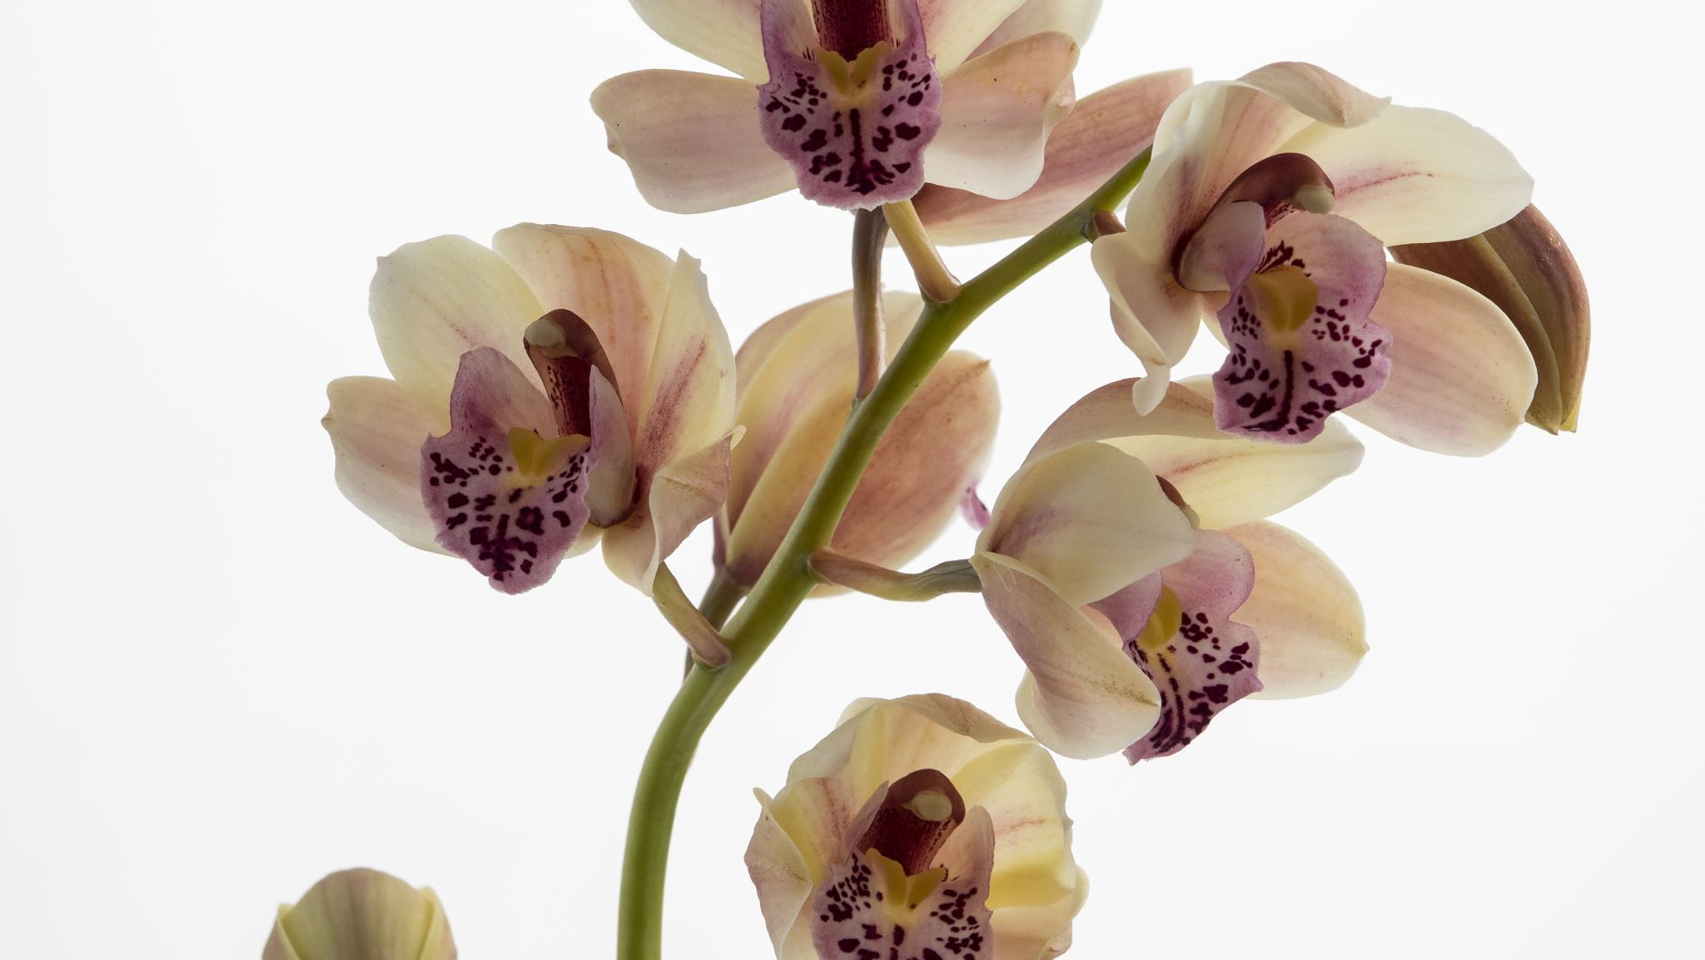
TASK 1 IRIS FLOWER CLASSIFICATION

Slide 3
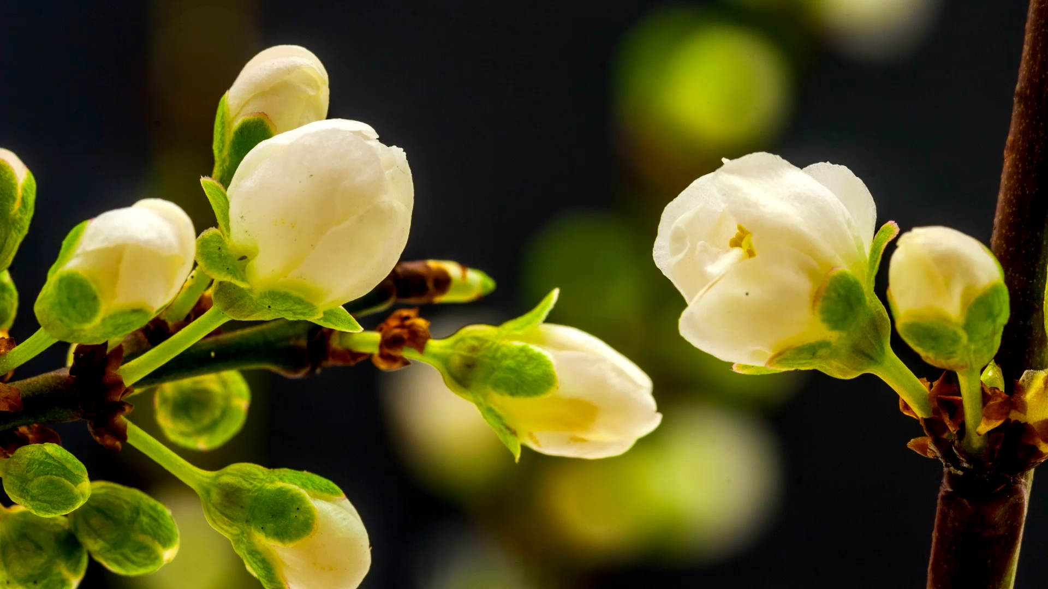
Iris flower has three species; setosa, versicolor, and virginica, which differs according to their measurements. Now assume that you have the measurements of the iris flowers according to their species, and here your task is to train a machine learning model that can learn from the measurements of the iris species and classify them.

Slide 4
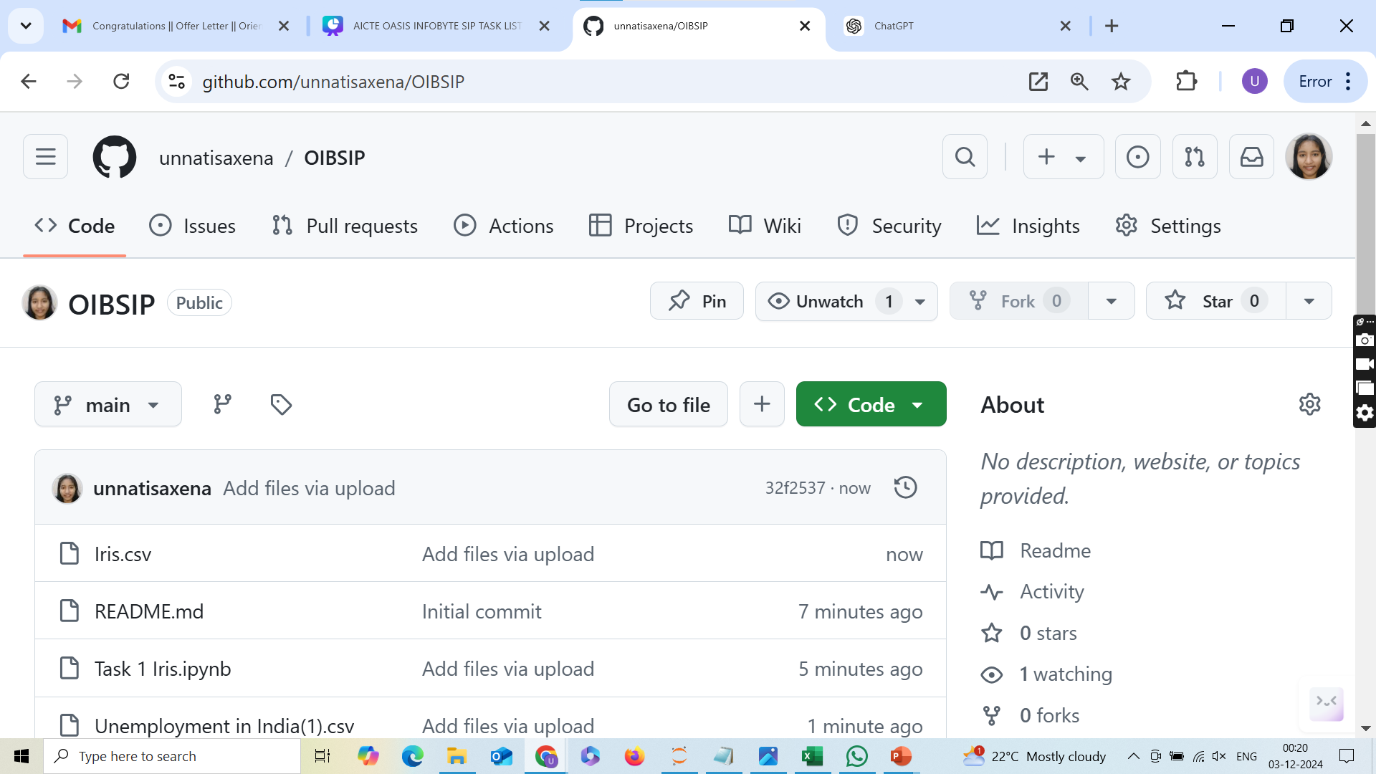
CHECK THE CODE IN THE GITHUB REPOSITORY https://github.com/unnatisaxena/OIBSIP

Slide 5

Questions? Let me Know. LinkedIn: https://www.linkedin.com/in/unnatisaxena/

